Slide 1
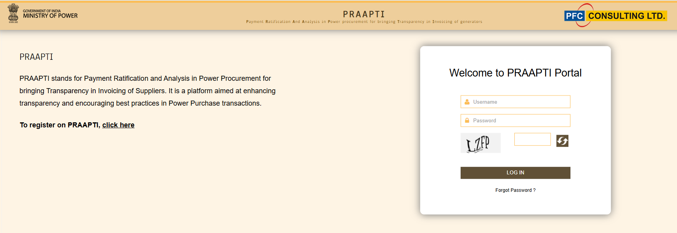
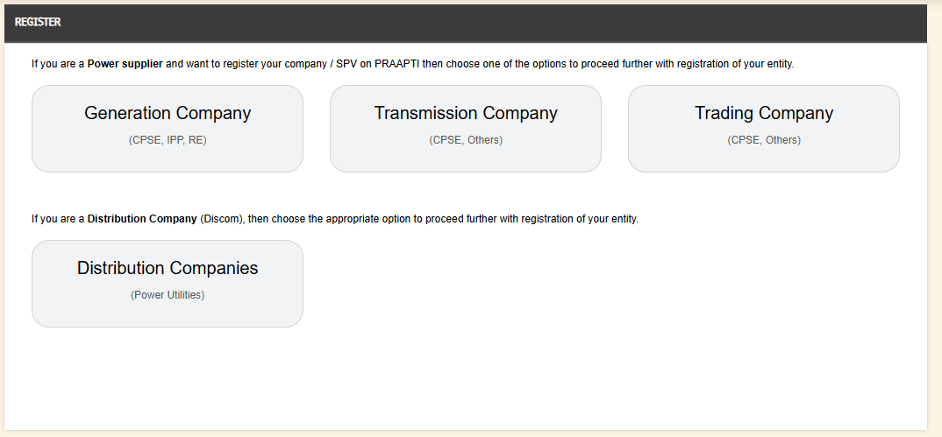
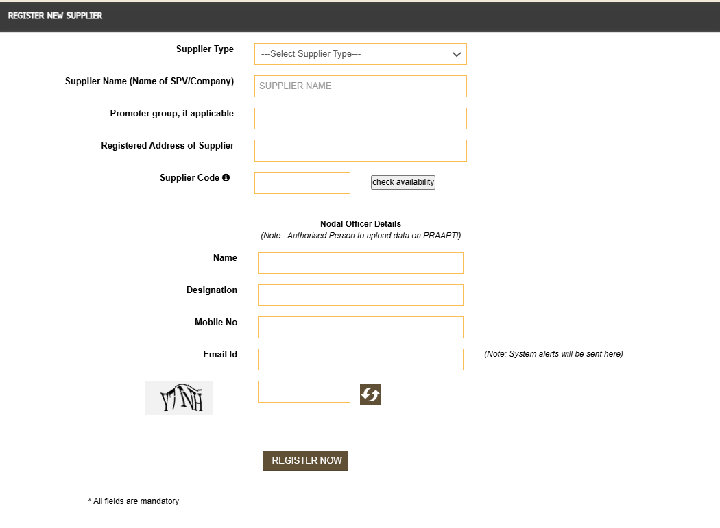
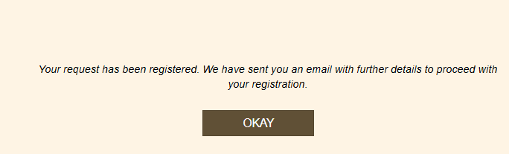
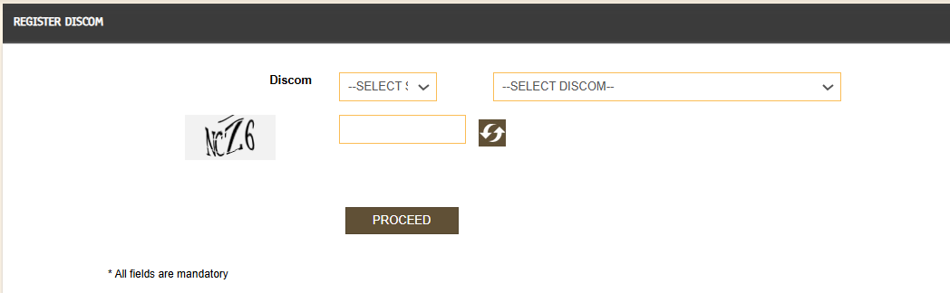
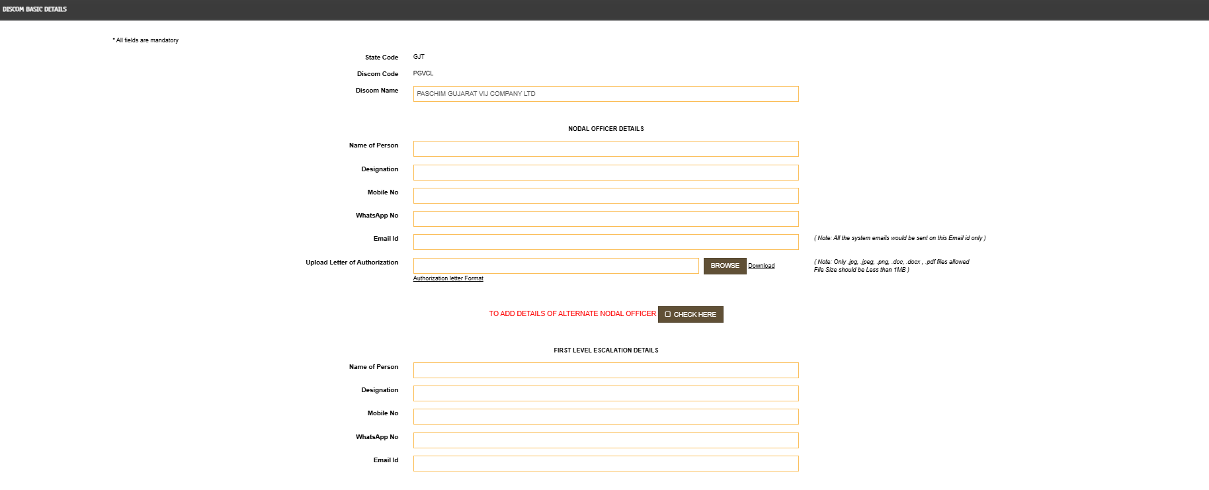
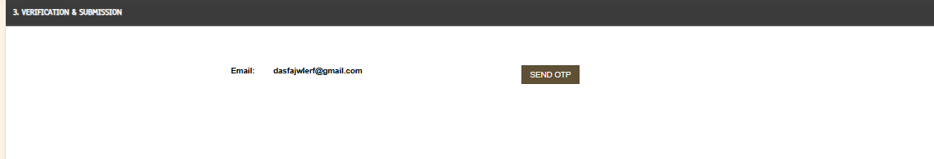
Mandatory Registration on PRAAPTI Portal for Users
SUPPLIER
Click the Registration link on PRAAPTI login page
Fill registration form details for new supplier
Email sent to the supplier. Registration approval by PFCCL.
DISCOM
Click the Registration link on PRAAPTI login page
Pre approved DISCOMs to proceed.
Fill in Discom and Nodal officer details
Email sent to the Discom. Registration approval by PFCCL.

Slide 2
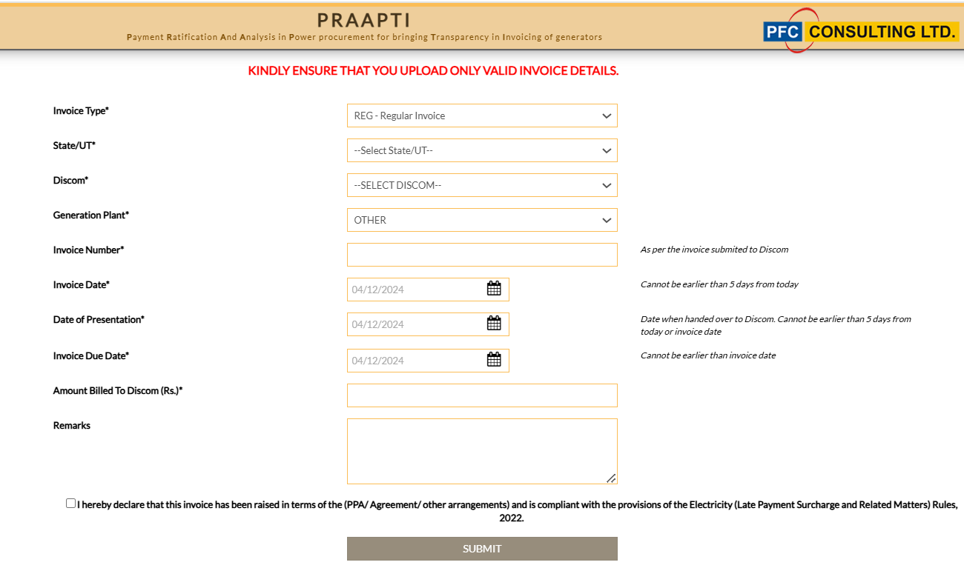
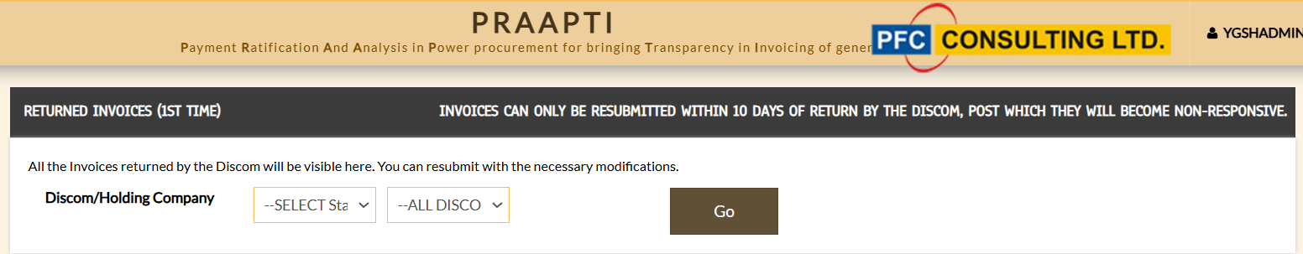
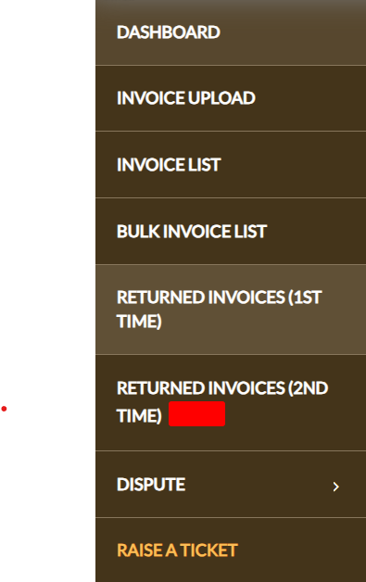
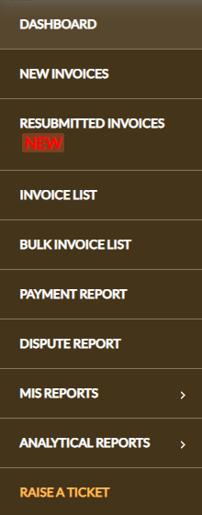

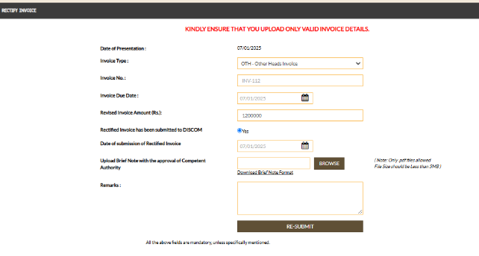
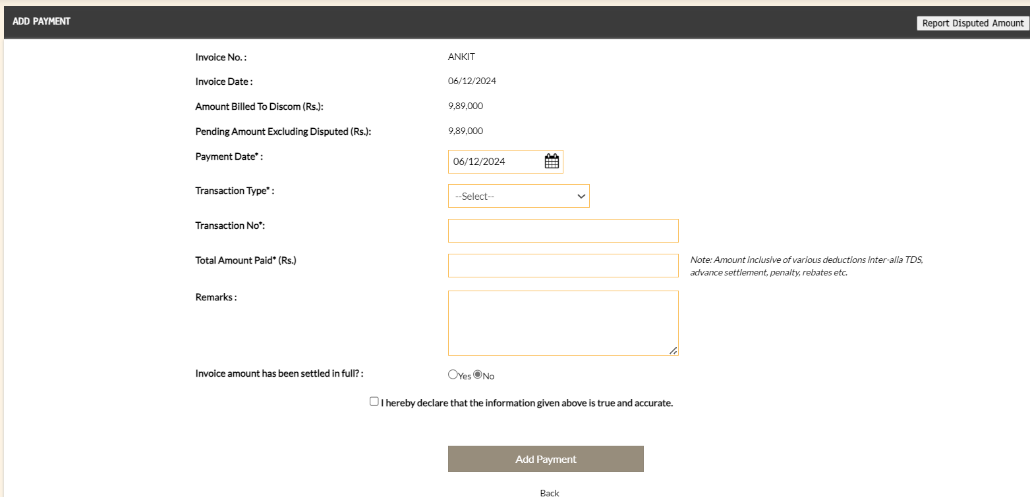

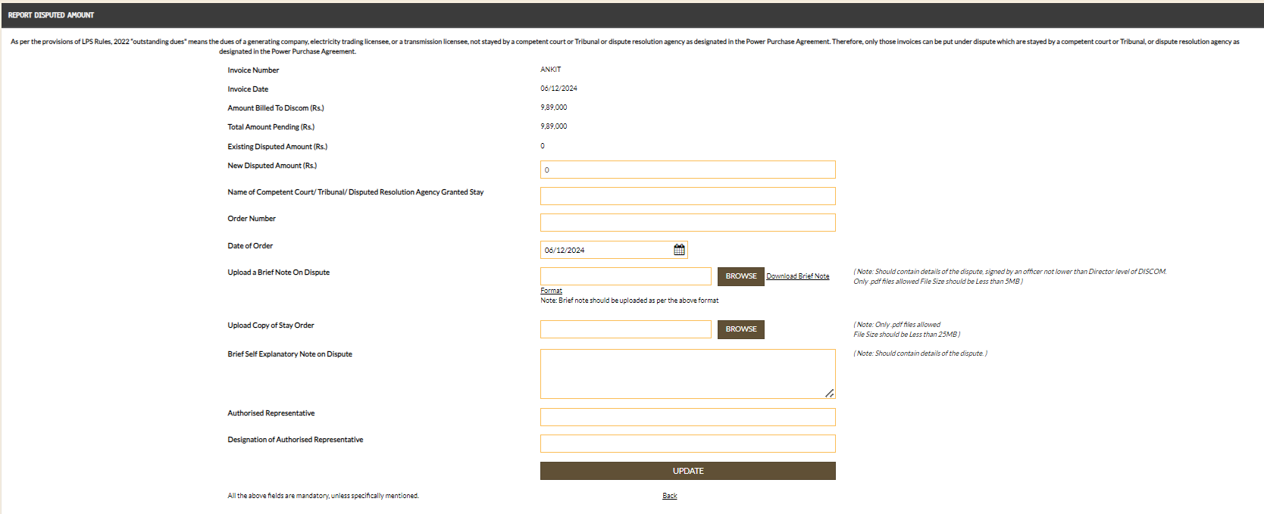
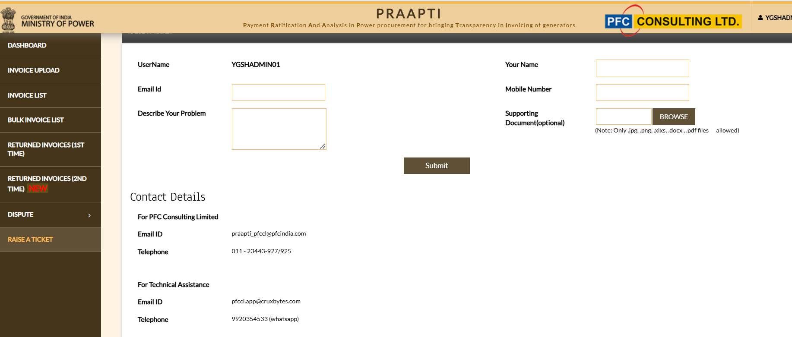
Key Features and Services
SUPPLIER ACTION
DISCOM ACTION
INVOICE UPDATE
INVOICE RETURN
RESUBMISSION OF INVOICE
PAYMENT UPDATION
OBJECTION TO DISPUTE
DISPUTE INVOICE
RAISE A TICKET (for Technical query)
Note: Auto-mailer sent to respective stakeholders for every action taken.

Slide 3
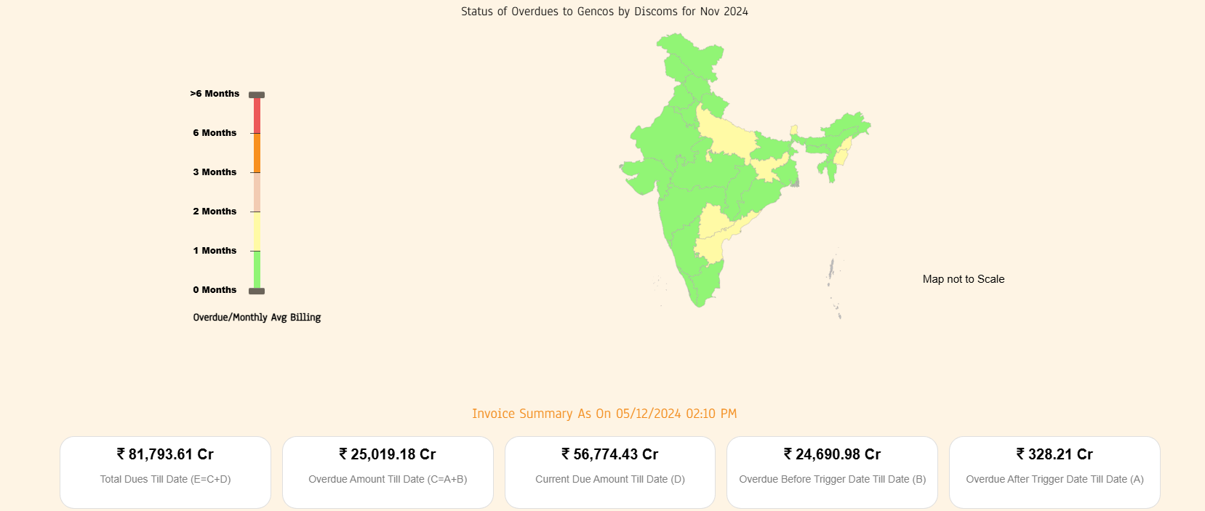
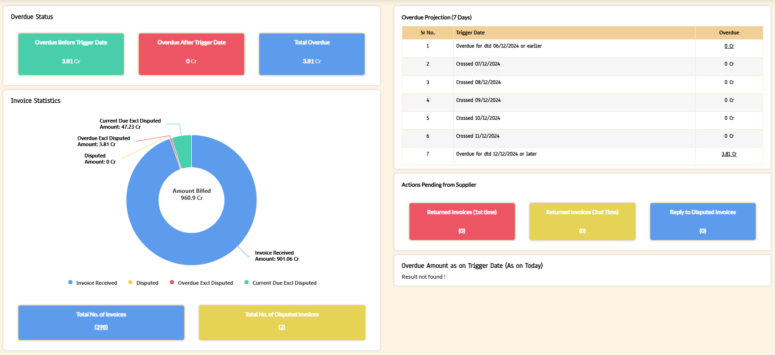
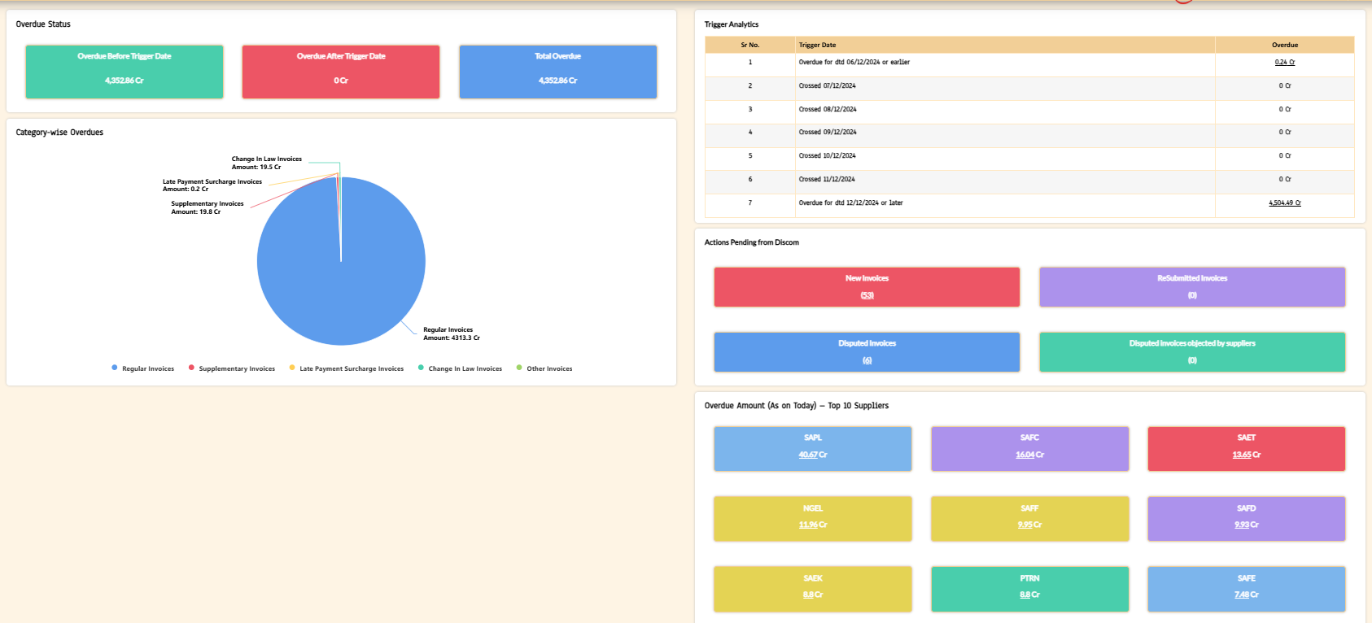
Dashboards
PRAAPTI Portal Dashboard
Dashboard views
Overdue details
Action to be taken by suppliers or Discoms
Invoice Statistics
Trigger date projections
Supplier Dashboard
Discom Dashboard

Slide 4
Standard Operating Procedure (SOP) for Invoice Update
If Not Rectified
Non-Responsive
Invoice remains in Dispute
Raise Invoice
Update Invoice details on portal
(DOP<=5days from DOI)
Rectification
(Within 10 days [loop-1] & 5days [loop-2] from updation*)
If Accepted
Supplier Accepts/ Rejects the Dispute
Auto-mailer to DISCOM;
Default trigger date to be generated
If Rectified
SUPPLIER
Auto-mailer to DISCOM
DISCOM
Check Invoice for Incompleteness (Within 10 days [loop-1-regular invoices], 5 days [loop-2-non-regular invoices*]
Auto-mailer to Supplier
Auto-mailer to Supplier
If Returned [for Non regular invoices]
(Ends after loop 2)
If Objected
If Returned
If Paid
Payment
(Enter transaction details & Certify) or Dispute the invoice
If not Returned
If Disputed along with a valid stay order
System confirmation for supplier
DISCOM to upload valid documents
If not Paid or disputed without valid stay order
Applicability of LPS Rules based on Default Trigger Date
Auto-mailer to Discom/Supplier on each step
If Uploaded
If Not Uploaded
Review by Committee
Invoice remains in Dispute
*Loop1- Regular/Other than Regular
Loop-2 : Only for “Other than Regular
Invalid Stay Order
Valid Stay Order

Slide 5
Dispute Resolution Mechanism
Invoice amount remains in Dispute
If not objected within 10 days
Supplier may object the Dispute
PRAAPTI Checks for the valid Documentary Evidence
If Objected
DISCOM Raises Dispute on PRAAPTI
Auto-mailer to Discom
If Valid
Auto-mailer to Supplier
PRAAPTI Checks for the valid Documentary Evidence
If Valid
Auto-mailer to DISCOM for appropriate action
If Not Valid
If Not Valid
Auto-mailer to Supplier
Applicability of LPS Rules based on Default Trigger Date
Review by Committee
Invalid Stay Order
Valid Stay Order
Invoice remains in Dispute

